Slide 1
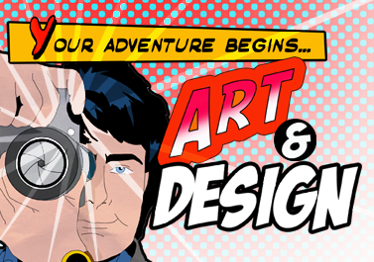
Year 6 Summer Project: Art and Design
Head of Art: Miss Nield

Slide 2
What is Art?
Art communicates an idea
Art is a visual way of representing the world and YOU!
Art expresses feeling and emotions
Art is a visual statement that represents the world around you and represents YOU!
Art communicates an idea.
Art expresses a feeling.
Art presents a personal response to different ideas through painting, design, photography, sculpture etc.

Slide 3
There are many careers you can have in Art and Design – here are just a few . . .

Slide 4
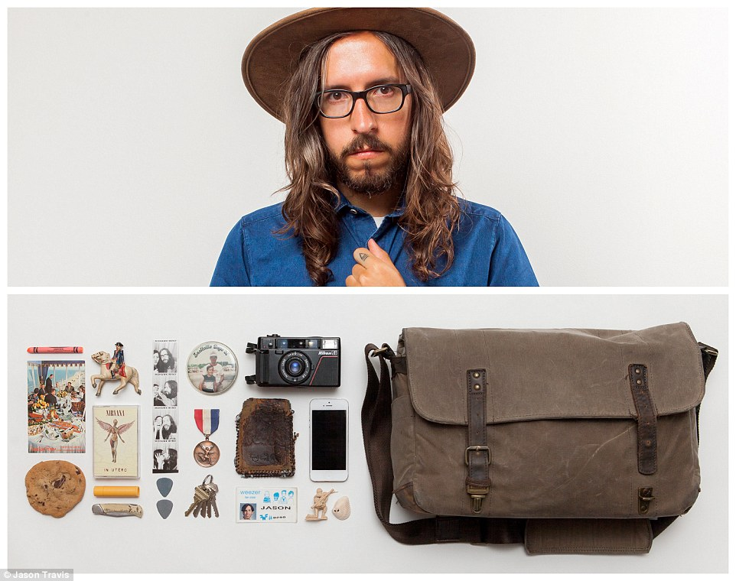
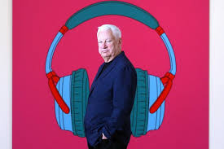
Your Summer Project
Two artists to inspire your summer project: Jason Travis and Michael Craig Martin
You are going to create a piece of artwork that says something about who you are.
You are going to show your identity using objects that say something about you – your likes, dislikes, hobbies and interests etc.
There are going to be 2 artists that will inspire your piece of art.

Slide 5
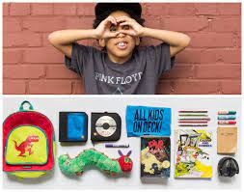
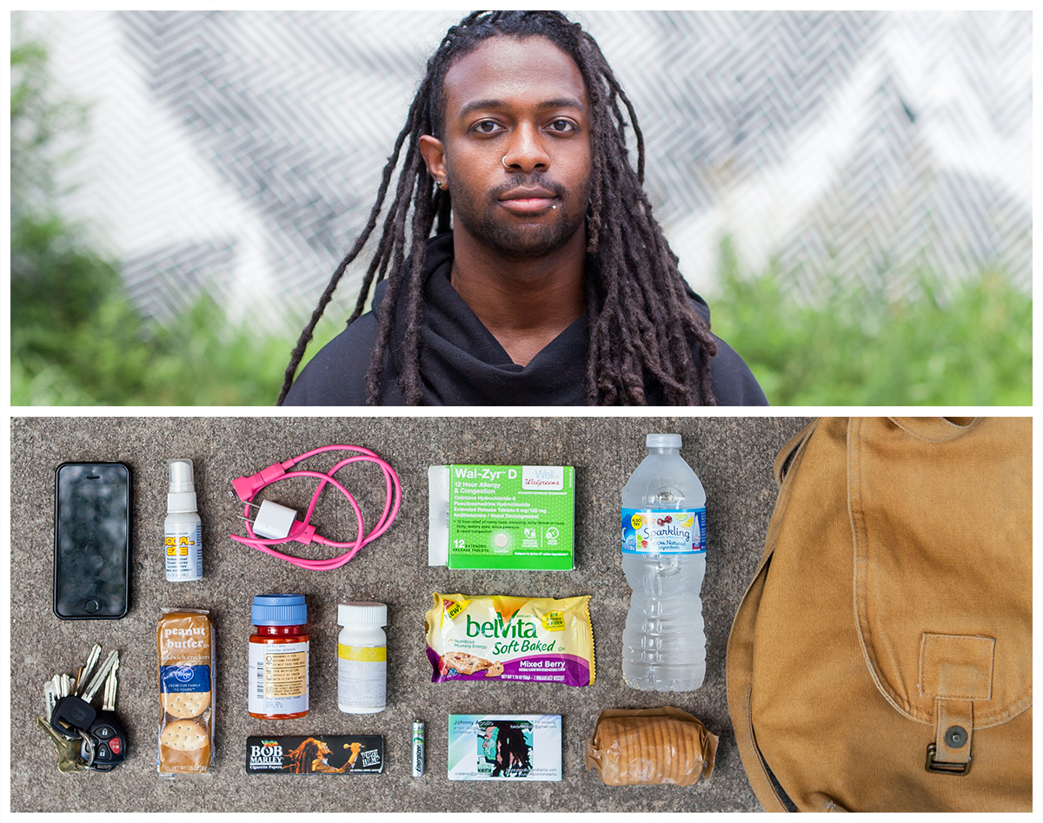
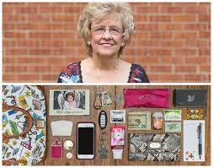
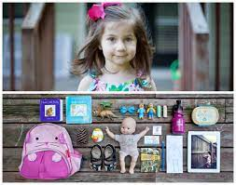
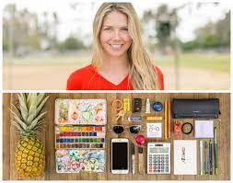
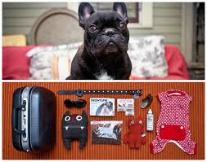
Jason Travis is an artist who lives and works in America. He created a series of artworks called ‘PERSONA’. He would ask everyday people that he would see on his way to work, if he could photograph their bags and what was inside them. These are the results . . . .
Travis believes that what you own, your belongings, say something about who you are as a person.

Slide 6
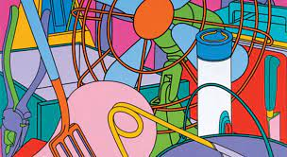
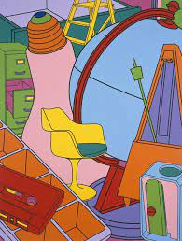
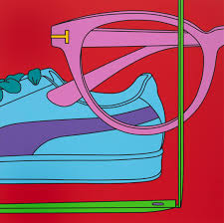
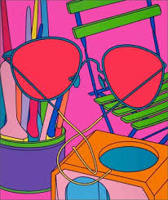
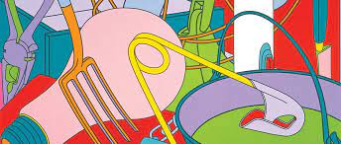
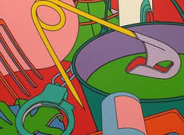
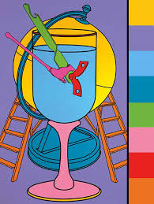
Michael Craig Martin is an Irish born painter who uses lots of bright and bold colours in his work. He created a series of artworks that show everyday objects that have been painted alongside each other in a fun and interesting way. Let’s take a look . . .
Michael Craig Martin believes that objects can represent your personality and when painted together, show who you are in a bright and fun way.

Slide 7
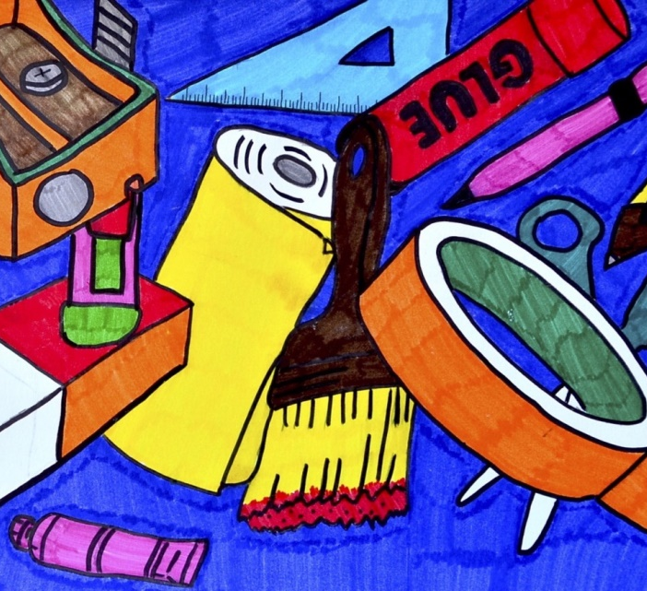
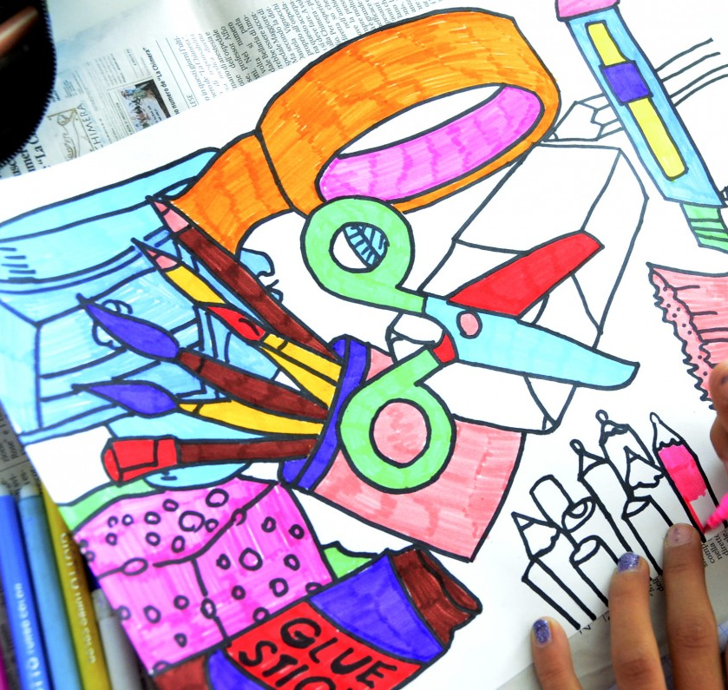
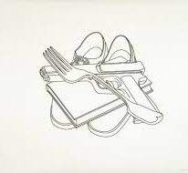
Materials to use:
A3 Paper
Paint, Coloured Pencils,
Collage – no Sharpies, highlighters or felt tip pens.
Task:
You are going to create a piece of art that shows who YOU are – a portrait without drawing your face.
You are only allowed to use objects that describe different parts of your personality (your hobbies, interests, favourite food, colours, subjects at school. Your favourite movies, books, places you have travelled etc.)
You are going to create your piece of art in the style of Michael Craig Martin. Be bold, colourful and play around with the size of your objects.

