Slide 1
Revision for Year 11

Slide 2
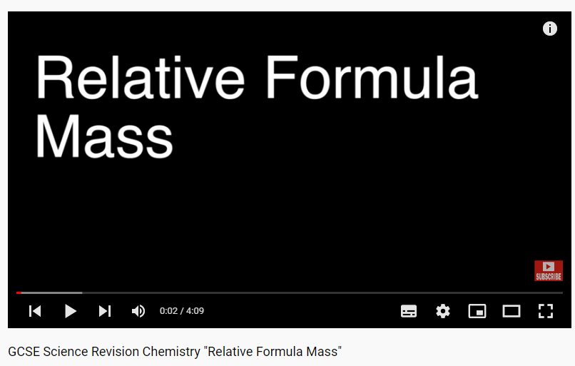
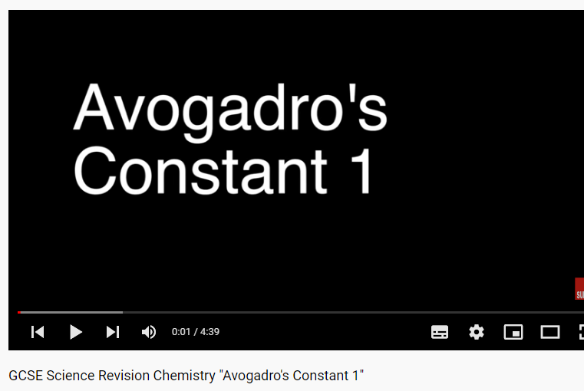
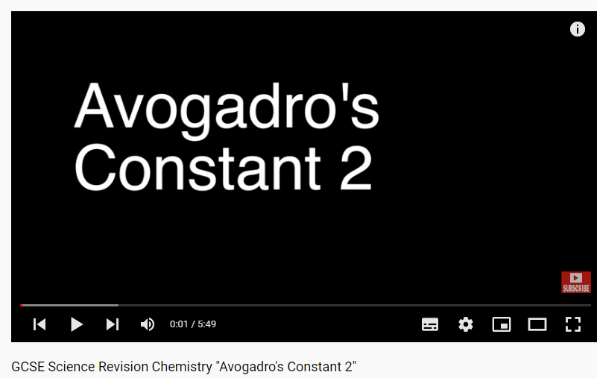
Triple- Support for Year 11’s over half term
https://youtu.be/tV8Cv2x0SD0
https://youtu.be/q49NwIrjaFw
https://youtu.be/-_-fNVmDwJk
https://youtu.be/TV6n5MFH6IU
https://youtu.be/3G3KQIyoZDI
https://youtu.be/h1-Vj6eh-mM
https://youtu.be/l_1vf1z8_OM
https://youtu.be/3y8YDlNeuRk
https://youtu.be/vxCyzR6uETs
https://youtu.be/MuzOmFhiE8o
https://youtu.be/9EV0Oq8g708
https://youtu.be/tYE-1nywlFs
https://youtu.be/OzutTl0sYd0

Slide 3
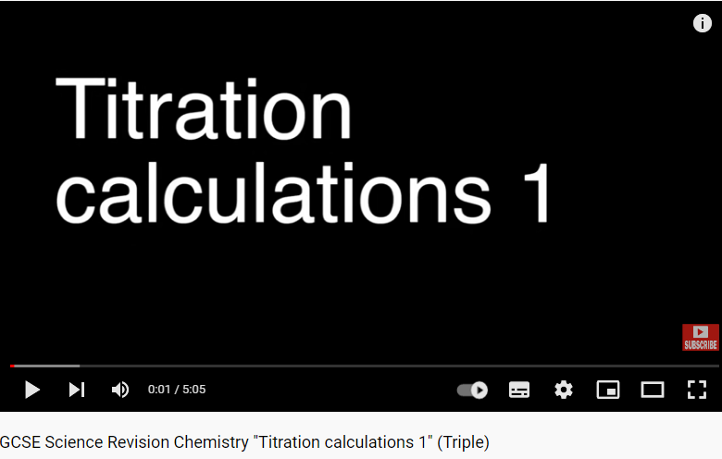
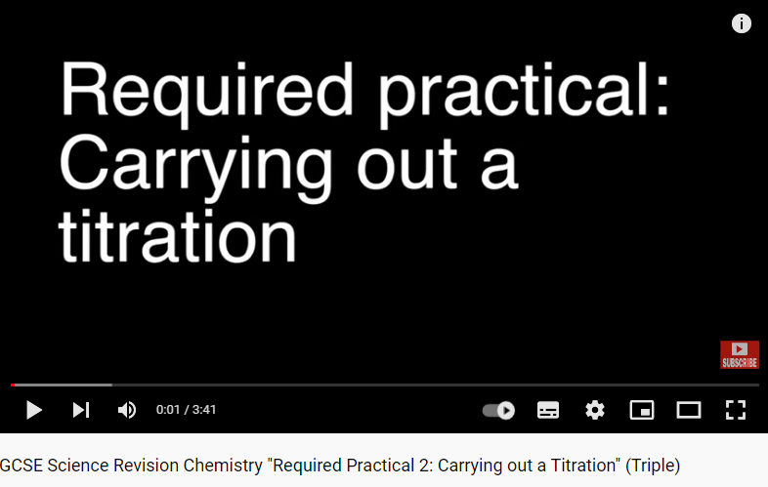
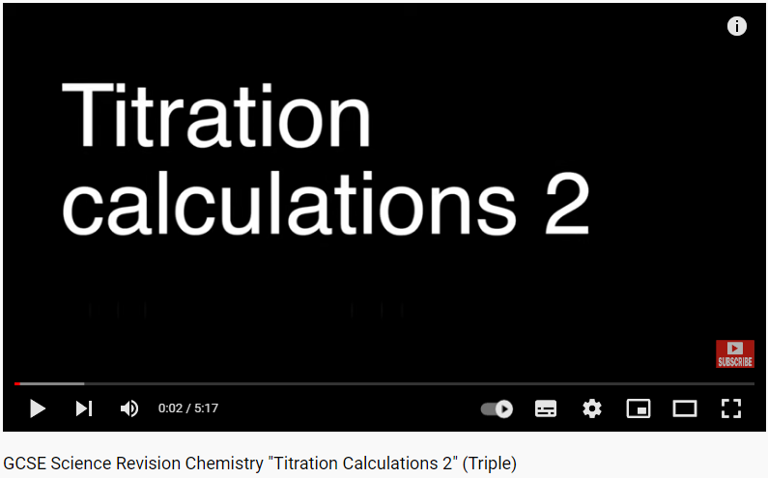
Triple- Support for Year 11’s over half term
https://www.youtube.com/watch?v=x8DLLCNMKAs
https://www.youtube.com/watch?v=saRBT5oZfh8
https://www.youtube.com/watch?v=ycC4oKteRJU

Slide 4
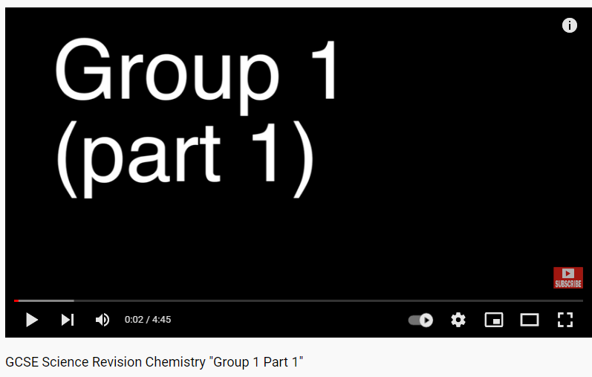
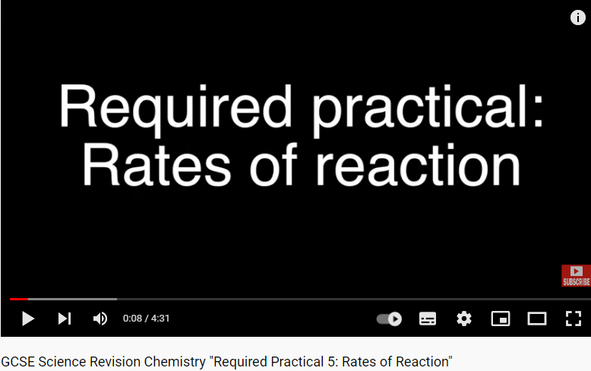
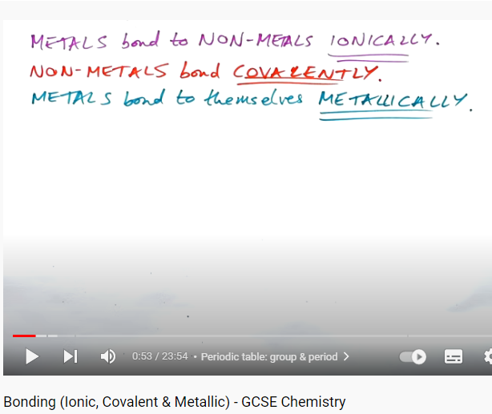
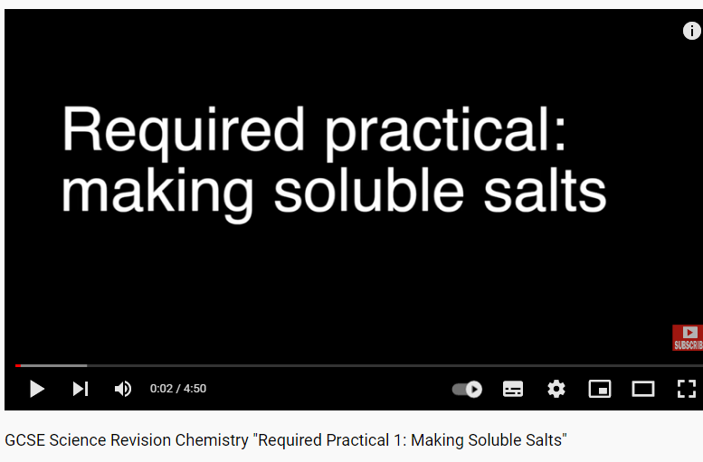
Combined and Triple- Support for Year 11’s over half term
https://youtu.be/UkrBJ6-uGFA
https://www.youtube.com/watch?v=aORsI-2dwnY
https://www.youtube.com/watch?v=N5p06i9ilmo
https://www.youtube.com/watch?v=SPXanyy3-hU
https://www.youtube.com/watch?v=p9MA6Od-zBA
https://youtu.be/K4pw_-U6Xpc
https://www.youtube.com/watch?v=9GH95172Js8
https://www.youtube.com/watch?v=uwzXfZoCP_k
https://www.youtube.com/watch?v=Yf-WhHZuqes
https://www.youtube.com/watch?v=IdS9roW7IzM

Slide 5
Triple and Combined- Support for Year 11’s over half term
https://youtu.be/tV8Cv2x0SD0
https://youtu.be/q49NwIrjaFw
https://youtu.be/-_-fNVmDwJk
https://youtu.be/TV6n5MFH6IU
https://youtu.be/3G3KQIyoZDI
https://youtu.be/l_1vf1z8_OM
https://youtu.be/3y8YDlNeuRk
https://youtu.be/vxCyzR6uETs
https://youtu.be/MuzOmFhiE8o

Slide 6
Combined set 5- Support for Year 11’s over half term
https://youtu.be/UkrBJ6-uGFA
https://www.youtube.com/watch?v=aORsI-2dwnY
https://www.youtube.com/watch?v=N5p06i9ilmo
https://www.youtube.com/watch?v=SPXanyy3-hU
https://www.youtube.com/watch?v=p9MA6Od-zBA
https://youtu.be/K4pw_-U6Xpc
https://www.youtube.com/watch?v=9GH95172Js8
https://www.youtube.com/watch?v=uwzXfZoCP_k
https://www.youtube.com/watch?v=Yf-WhHZuqes
https://www.youtube.com/watch?v=IdS9roW7IzM

Slide 7
Foundation Combined set 5 - Support for Year 11’s over half term
https://youtu.be/tV8Cv2x0SD0
https://youtu.be/q49NwIrjaFw
https://youtu.be/-_-fNVmDwJk
https://youtu.be/TV6n5MFH6IU
https://youtu.be/l_1vf1z8_OM
https://youtu.be/3y8YDlNeuRk

